Slide 1
Find the Best Location to Open an Restaurant in Toronto Area
Capstone Project - The Battle of Neighborhoods

Slide 2
Background
My proposal for this project is to find the best place to open a Brazilian restaurant in Toronto. I will take advantage of the fact that I am Brazilian and I know this very special cuisine very well and use the knowledge and tools of the course to find the best place to open a new restaurant.
Choosing the right place to start a business is one of the first and very important decisions and determines important aspects in the management and development success rate. Different factors that can directly affect the success chance of business. It is important to evaluate neighborhoods based on the factors that are important for running a successful business such as the number of competitors and the potential demand in that neighborhood. Budget limitations in renting or buying a place that plays an important role in location decision making for small businesses.

Slide 3
Business Problem
There is not an exact single "national Brazilian cuisine" but there is an assortment of various regional traditions and typical dishes. This diversity is due to the origins of the people inhabiting each area and it makes this cuisine so special. In this project, I want to find the best neighborhood in Toronto to open a Brasilian cuisine restaurant. The challenge is to find a suitable neighborhood that is close enough to some amenities and venues, has fewer competitors, and of course is affordable to rent. The restaurant is good to be near a place where many people visit such as near a cinema, park, garden, playground, and theater.

Slide 4
Data
I will use the Toronto data set acquired from Wikipedia (https://en.wikipedia.org/wiki/List_of_postal_codes_of_Canada:_M). The data set consists of latitude and longitude, postal codes obtained from https://cocl.us/Geospatial_data
Foursquare API Data: I will use Foursquare API locational information in a similar way we did in the course.
After obtaining the list of neighborhoods, I can use the Foursquare API to collect information about places within each neighborhood.
The data retrieved from Foursquare contained information of venues within a specified distance of the longitude and latitude of the postcodes. Afterward, I can use the K-means clustering algorithm to find the best place to open the restaurant.

Slide 5
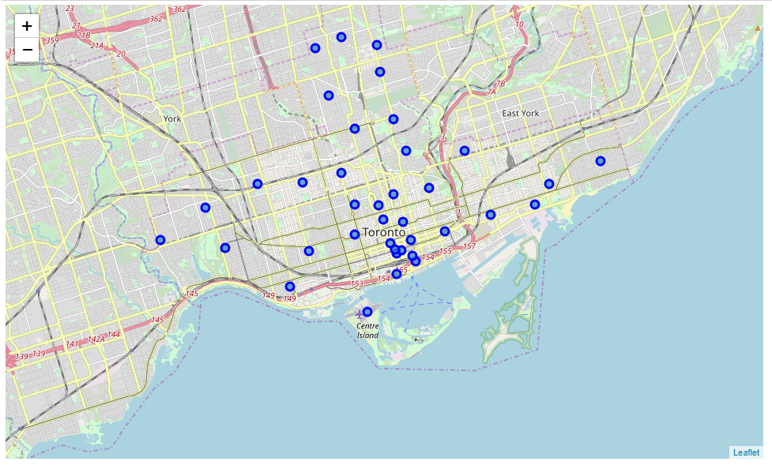
Neighborhoods of Toronto used in this study

Slide 6
Methodology
Cluster the neighborhoods using k-means to cluster the neighborhood into 10 clusters based on the frequency of different venue categories.
Sort the neighborhoods in each cluster
Select the neighborhood with least restaurants and more interest places to atract people to go to a restaurant.

Slide 7
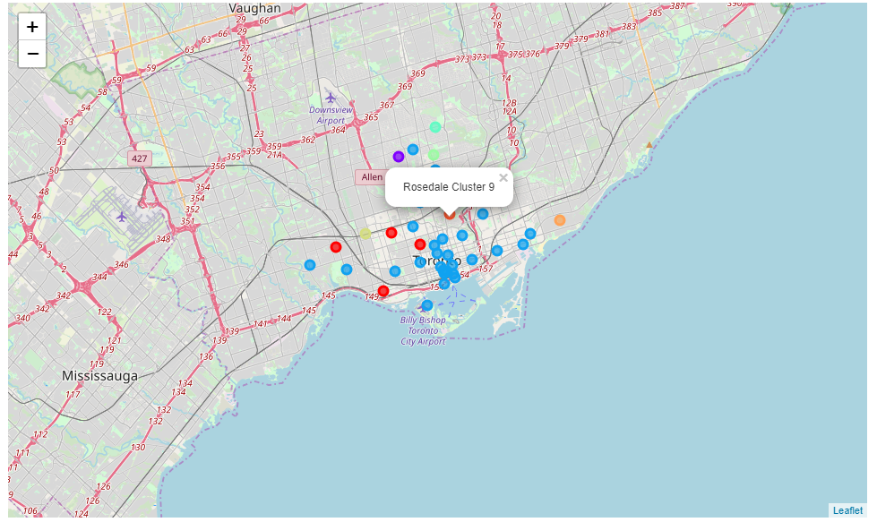
Use KMeans to cluster the neighborhoods of Toronro into 10 classes

Slide 8
Results and Discussion
Looking at the results in terms of clusters, the best places to open a Brazilian restaurant would be clusters 4 to 9, as they are the ones with the least amount of restaurants. Other criteria need and should be analyzed, like other places that people usually go before going to a restaurant and the competition from other restaurants.

Slide 9
Conclusion
The purpose of this project was to identify Toronto areas with a low number of restaurants in order to search for the optimal locations for a new Brasilian restaurant. From Foursquare data we have first identified general boroughs and then clustering of those locations was then performed in order to create major zones of interest. The final decision on optimal restaurant location will be made by stakeholders based on specific characteristics of neighborhoods and locations in every recommended zone, taking into consideration additional factors like the attractiveness of each location, prices, social and economic dynamics of every neighborhood, etc.

